Slide 1


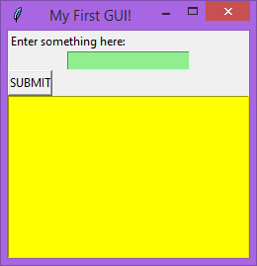
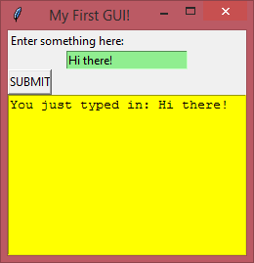
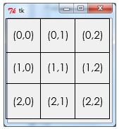
GUI Building with TKinter
Lesson 1 - Introduction

Slide 2
Installing Python at home
It is highly recommended that you install Python on a computer at home so that you can complete any homework set and practise the code you will learn in these lessons.
Go to https://www.python.org/ to download the latest version of Python.
It is also highly recommended that you spend time outside of lessons practising the basics of Python coding using the videos that can be found on the resources website using the link below:
https://sites.google.com/cardiffhigh.co.uk/a-level-cs/year-12/python-programming

Slide 3
Installing Python at home
Tkinter is included with all versions of Python from version 3.7 onwards, so once you have installed Python you can go straight to importing the Tkinter library (see slide 7).

Slide 4


Activity 1
5mins
Research the following:
What is a GUI?
Find as many libraries as you can that allow you to create GUIs in Python

Slide 5
Intro to GUIs
A graphical user interface (GUI) is simply a ‘screen’ that allows a user to interact with their computer through graphics such as menus and buttons.
In python there are a number of libraries which can help build GUIs. This document will introduce the ‘Tkinter’ toolkit library which comes as standard with Python 3 (other GUI libraries have to be downloaded separately such as pyQT and wxpython).

Slide 6
Today’s lesson
This lesson will walk you through the basics of Tkinter, from importing the necessary module to creating your first simple GUI program.
Make sure you follow the steps carefully. If something doesn’t work, check that you have written the code exactly as it appears in the examples before asking for help.
Learning Objectives:
Understand what a GUI is
Understand what the Tkinter library provides
Understand the ROOT window, it’s MAIN LOOP and how to construct a ROOT window
Understand what a widget is
Understand how to position widgets in the window
Understand how to create a label widget
Understand how to create an entry widget
Understand how to create a button widget
Understand how assign a command to the button
Understand how to create text widget

Slide 7
Tkinter – basics walkthrough
Importing the ‘tkinter’ Library
In order to make use of the tkinter library it first needs to be imported. To import the library simply write the following at the top of your program code:

Slide 8
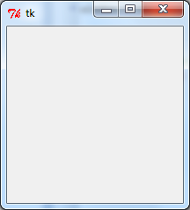
Tkinter – basics walkthrough
Creating a Window
The next job is to create a window for your GUI. To do this we create a window object from the tkinter library:
This object doesn’t have to be called ‘window’, but it makes sense to do so. Also, notice that the object is being created from the class Tk() where the ‘T’ is capital.
The result of this code is shown here:

Slide 9


Tkinter – basics walkthrough
Adding a ‘Title’ to the Window
Next we can add a title to the window (which will appear in the bar at the top of the window by using the following code:
As you can see, this code has added a title to the bar at the top of the window:

Slide 10


Tkinter – basics walkthrough
The mainloop()
Finally we add the code to run the ‘event loop’. When the program runs, the event loop continues to check if any events have occurred (button clicks, keyboard strokes etc).
As each event occurs, it is added to a data structure in readiness for processing. To ensure that the events are kept in order and cannot be overwritten, programmers will make use of a specialist data structure known as a queue. A queue is nothing more than a list which is limited to only allow data to be inserted from one end, and retrieved from the other.
In tkinter the event loop is known as ‘mainloop’. We run the ‘mainloop’ method of our window object in the following way.

Slide 11
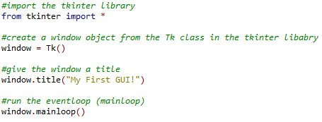
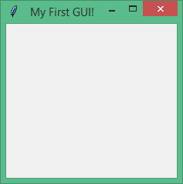
Tkinter – basics walkthrough
Summary
Here is what your code and output should look like so far:
It would be beneficial for your understanding of the code if you also include the comments shown here. This will also help you when you come to revise for your practical exam.

Slide 12
Tkinter – basics walkthrough
Widgets
In programming, we call the different items that you might find in a GUI, “widgets”. The main widgets that GUIs will contain are ‘labels’, ‘buttons’, ‘text boxes’, ‘drop down menus’, ‘check boxes’ and ‘radio buttons’.
The next few slides will show how some of these widgets can be created and positioned in our new GUI window.

Slide 13
Tkinter – basics walkthrough
Organising / Arranging Widgets
Before we create some widgets lets first look at how these widgets can be arranged in the window.
With the tkinter library, the window is arranged into a grid with as many columns and rows as we require. Each row and column is numbered so that the cells can be referenced by coordinates.
As is common practice in computing, the coordinates start (0,0) from the TOP LEFT.

Slide 14
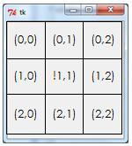
Tkinter – basics walkthrough
Organising / Arranging Widgets
As well as adding widgets into the cells of a grid, we can also state where we want these widgets to be positioned INSIDE the cells.
We do this by using the ‘sticky’ property. We can get the widgets to stick to either the top, bottom, left or right of the cell. We do this using the compass directions north (N), south (S), east (E) and west (W). We use capital N,S,E and W when using the ‘sticky’ command.
You can further improve the control you have in positioning widgets and the general layout of a window by using a frame widget. We look at frame widgets later.

Slide 15

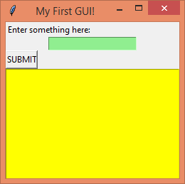
Tkinter – basics walkthrough
Label Widgets
The label widget is probably the most simple. It just provides an area for some text to be displayed.
To create a label we use the ‘Label’ command (notice the capital ‘L’). We then say where we want it to be placed (in this case it is inside the window object) and then we write the text that the label is to contain. Finally we use the ‘grid’ method to position the widget inside our window in a location of our choice.
Here is an example:
…and this is the result:

Slide 16
Activity 2
5mins
Write a program which creates a window with the title “My First GUI”, and that displays a message of your choice.
Save this as “Lesson 1 activity 2.py”

Slide 17

Tkinter – basics walkthrough
The Entry Widget
This widget provides a place to enter text. It could be added the same way as the label widget. However, as entry widgets are usually a place for the user to enter different inputs, we will often want to refer back to entry boxes later. Because of this, it is usually best to assign an ‘Entry’ widget to a variable name so that we can call on it elsewhere in our code.
Here is an example of creating an entry widget, assigning it to a variable and then positioning this variable using the grid() method.
…and the result is this:
*IMPORTANT: When assigning the entry box to the variable, don’t try to write the grid() method at the same time as the assignment will not work properly. It needs to be done in two stages like it was above.

Slide 18


Tkinter – basics walkthrough
The Button Widget
The button widget provides a button. To create a button we use the following code:
…except that we need to add a value into the command.
What is needed next to “command=” is the name of a function. This is because when a button is clicked it needs to execute some code and so by adding the name of a function here, will allow the button to execute a function when it is clicked.
So, let’s create a function which will ‘collect’ the text that a user might write into the ‘Entry’ box and then print it to the console:

Slide 19
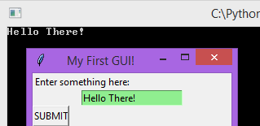
Tkinter – basics walkthrough
Now, let’s update the Button code so that it executes this function when clicked:
This is the result:

Slide 20
Tkinter – basics walkthrough
The Text Widget
A text widget is one which displays text, a little like a label. To create one we use the following code:
Like we did for the entry widget, it is best to assign text widgets to variables as often we will want to call on text widgets so that they can be updated, when a button is clicked, to display new text.
Notice also the ability to set height and width, to allow text to wrap onto another line when the window is resized and the option to set a background colour.
On the grid method, notice the ‘columnspan’ property. This allows widgets to be positioned across columns, which may be a useful option when trying to arrange widgets more professionally.

Slide 21
Tkinter – basics walkthrough
This is the result of this code:

Slide 22
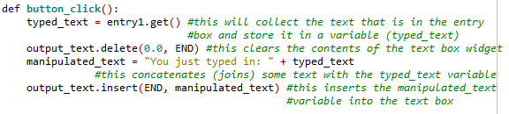
Tkinter – basics walkthrough
Finishing off the button action
Previously we created a function to be executed when the button was clicked. The function collected the text that was entered into the ‘entry’ box. Now that we have a text box, we can update the function so that it can manipulate and output the inputted text.
As you can see from the code above, I added three more lines of code. In the first, the delete method is used to delete the contents of the text widget. The ‘0.0’ argument says “start deleting from line 0 and at character 0” (remember computer scientists count from zero). END refers to the last character. So this will delete all characters starting at the first character and finishing off with the last.
The second line concatenates (or joins) the text ‘You just typed in: ’ with the contents of the typed_text variable and stores it in a new variable ‘manipulated_text’.
The final line inserts the new ‘manipulated_text’ variable into the text box widget using the insert method. The arguments of this method state the position where an item is to be inserted and the item itself. So as we already learnt, END refers to the last character in the text box (which in this case is the start as we have deleted the text box’s contents) and the item to be inserted is the manipulated_text variable

Slide 23
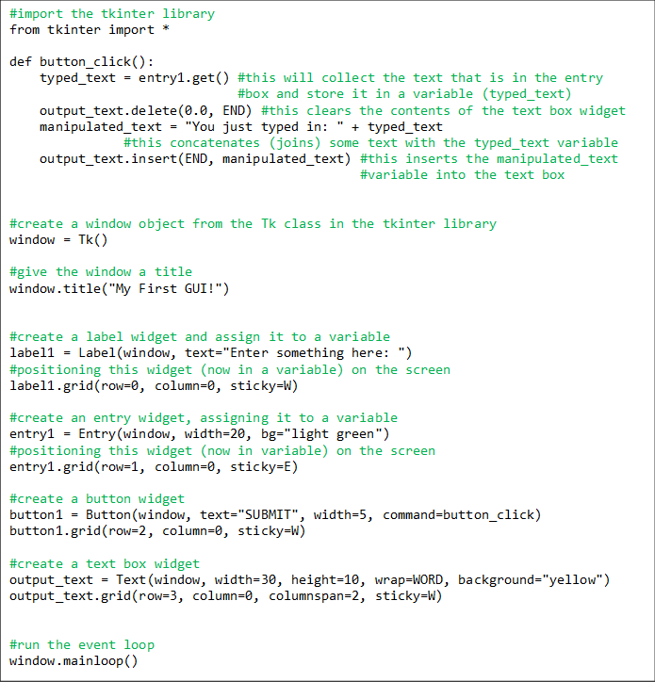
Tkinter – basics walkthrough
…and this is the final result:
Here is what the code for the full program should now look like:

Slide 24
Activity 3
5mins
Develop your GUI so that it also can copy text entered into an entry box and place it in a text box (concatenated with a message) when the button is clicked.
Save this as “Lesson 1 activity 3.py”

Slide 25
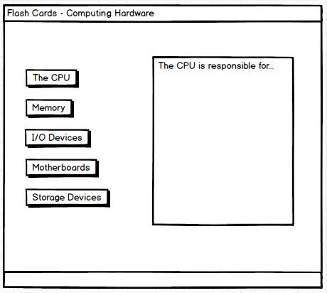
Activity 4
Rest of lesson
and Homework
Create a ‘FLASH CARD’ GUI program.
Pick a topic in computing (e.g. Computing Hardware) and create a program which has a series of ‘buttons’ and a ‘text area’.
When each button is clicked, information about that part of the topic is presented in the text area.
The image shown on the right is an example – yours does not have to look exactly like this. Feel free to experiment with the layout and the colours used.
Save this as “Lesson 1 activity 4.py”

Slide 26
Uploading your work
You should now have 3 complete Python files. On Google classroom you will find an assignment for this lesson, and you need to upload your completed Python files to this assignment.
If you have any problems doing this, please speak to your teacher.

